Slide 1
Title IX Training Grades 7-12
“Student safety is my number one priority. I take very seriously and very personally any incident that may negatively impact our communities, kids and families.”
Dr. Deena Bishop, Superintendent

Slide 2
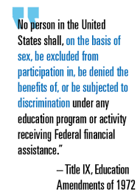
Title IX
Notes:
Today we are going to talk about an important law called Title IX.
Title IX is the law that requires all students be treated fairly, regardless of their sex, gender identity and sexual orientation. The law aims to eliminate discrimination and bullying so that we all feel safe in school.

Slide 3
Title IX Covers
Safety
School environment
Discrimination, bullying and harassment
Sexual Harassment
Sexual Assault
Sports participation
All programs or activities
All students and all staff
Notes:
Title IX of the Education Amendments of 1972 was enacted to eliminate discrimination based upon sex and eliminate sexual harassment in schools that receive federal funds, including public school districts.
As a result of Title IX, schools undertake a broad range of efforts to ensure student safety by eliminating bullying, discrimination, and harassment based upon sex and also to eliminate sexual assault and sexual violence in public school activities and programs.

Slide 4
Safety
“The Anchorage School Board and Administration are committed to providing an open learning environment where students and employees feel safe, cared for, and that they belong.”
Dr. Deena Bishop, Superintendent
Notes:
The Superintendent of the Anchorage School District is responsible for all the schools in the school district.
The Superintendent knows that for you to have a positive experience at school, you must feel safe. Title IX requirements ultimately support the goal to provide you a learning environment in which you feel safe while in school.
“The Anchorage School Board and Administration are committed to providing an open learning environment where students and employees feel safe, cared for, and that they belong.”
-Dr. Bishop Superintendent

Slide 5
ASD Rules
ASD Board Policy 5145.7
The Board shall not tolerate the sexual harassment of any student by any other student or any district employee. Any student or employee who is found guilty of sexual harassment shall be subject to disciplinary action.
ASD Administrative Regulation 5145.7
It is the intent of the Anchorage School District to provide an environment for students that is free from sexual harassment and sex-based discrimination whether based on sex, gender identity, sexual orientation, gender nonconformity, transgender status, or any other unlawful consideration.
Notes:
The Superintendent of the Anchorage School District is responsible for all the schools in the school district.
The Superintendent knows that for you to have a positive experience at school, you must feel safe. Title IX requirements ultimately support the goal to provide you a learning environment in which you feel safe while in school.
“The Anchorage School Board and Administration are committed to providing an open learning environment where students and employees feel safe, cared for, and that they belong.”
-Dr. Bishop Superintendent

Slide 6
Discrimination
Notes:
Discrimination occurs when people are bullied, harassed or treated unfairly because of a characteristic such as sex, race, national origin, or disability.

Slide 7
Sex-based Discrimination
Notes:
Title IX specifically prohibits sex-based discrimination and sexual harassment in school programs and activities. This is when someone bullies, harasses or discriminates against someone else because that person is a male or a female, or because the person is not acting the way the harasser or bully thinks a male or female person should act.
Title IX also protects us from being discriminated against for our gender or sexual identity, such as when we identify as lesbian, gay, bisexual, transgender, straight, or by some other gender or sexual identity.
It is unlawful to discriminate against, bully, or harass someone because of their sexual identity, their gender identity, or because of perceived gender nonconformity.

Slide 8
Sexual Harassment and Bullying
Verbal
Written
Non-verbal
Physical
Notes:
Title IX also prohibits sex-based harassment or bullying. There are four kinds of harassment and bullying we will discuss today: verbal, written, non-verbal, and physical.

Slide 9
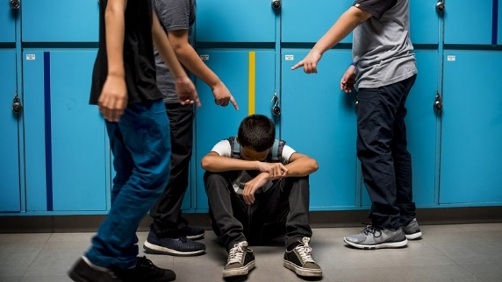
Verbal Harassment Can Be Sexual Harassment
When someone says something mean or hurtful.
Notes:
Verbal harassment or bullying happens when someone, or a group of people, repeatedly says something that is mean or hurtful.
Verbal harassment can also be sexual harassment when the words used are sexual in nature and are part of a pattern of verbal conduct.
Examples of verbal sexual harassment might include sexual jokes, unwanted comments about your body, or unwanted comments about someone’s own sexual conduct.

Slide 10
Written Harassment/ Cyberbullying
Written messages that are mean or hurtful can be written on paper, online, through text messages or social media.
Notes:
Written or cyberbullying is when mean or hurtful messages are written down on paper, online, or spread through apps like Instagram or Snapchat.
Pictures, videos and messages that are put online can go viral quickly and spread around the school. This can create a hostile environment where people don’t feel safe coming to school.
If this happens to you or someone you know, tell an adult.
If someone you don’t know is trying to talk to you online, tell an adult.

Slide 11
Non-verbal Harassment
Staring
Checking Someone Out
Inappropriate Gestures
Notes:
Another type of harassment or bullying is called non-verbal harassment. In terms of sexual harassment, this might include staring, checking someone out, or using inappropriate sexual gestures.

Slide 12
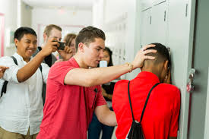
Physical Harassment
Notes:
Physical harassment or bullying is using one’s body and physical acts to exert power over peers. Punching, kicking, hazing, and other unwanted physical attacks are all types of physical harassment and bullying.

Slide 13
Sexual Violence and Assault
Physical contact of a sexual nature.
Sexual contact without consent.
Notes:
Title IX also protects us from sexual harassment and sexual violence and assault.
Sexual assault occurs when there is sexual contact without the other person’s consent. Consent means that the other person has told you that it is okay to touch them.
Sexual assault can include any nonconsensual physical contact with the private parts of the other person’s body. Those are the parts of the body that are covered by a swimming suit.
Sexual assault can include contact with these private areas up to, and including, sexual intercourse.
Even in the context of dating, consent must be given by both parties. If an individual is coerced, not freely able to agree, or unable to give consent, the act becomes sexual assault. Sexual assault is a crime, and if an individual is found guilty of sexual assault it may be considered a felony and include jail time.
It does not matter whether or not you are sexually attracted to the other person. If you touch another person in their private areas without their consent, that is sexual assault.

Slide 14
Three Rules
Say No
Get Away
Tell Someone
Notes:
Remember, sexual harassment is NOT flirting. If sexual conduct or remarks of a sexual nature make you feel uncomfortable or is unwanted, the conduct or comments are not acceptable and may violate Title IX.
Sexual harassment can happen to anyone by anyone regardless of gender or age.
There are three rules to remember if you feel uncomfortable or unsafe:
-say no
-get away
-and tell someone

Slide 15
Tell Someone
Teacher
Parent
Counselor
Principal
Custodian
Classroom Aide
Cafeteria Staff
Notes:
Think about who you might talk to if you feel unsafe or uncomfortable.
This person could be your teacher, a parent, counselor, principal, custodian, classroom aide, cafeteria staff, or any other adult at the school.

Slide 16
Quiz
A student reports to the school principal that she was sexually assaulted at school. The school forwards the report to the police department, and the school does not do its own investigation.
Title IX concern?
Notes:
YES
School districts have an independent obligation to timely investigate a student’s Title IX claim.
The police department may ask the school not to interview students until officers can interview them as possible witnesses in the criminal case. The school can agree to a brief delay, but the school must then promptly complete its own investigation.

Slide 17
Questions?
Notes:
It is okay if you have questions about Title IX and what we talked about today.
If you have questions, you can talk to your teacher or another adult at your school.
We will also give you a handout with some tips to help you remember the key points of Title IX.
The adults in your home may want to call us and ask questions, too.
Remember if you ever feel unsafe or uncomfortable you should say no, get away and tell an adult.

Slide 18
Contact Us
ASD Office of Equity & Compliance
Title IX Coordinator
Equity@asdk12.org
(907) 742-4132

